Slide 1
Smoking cessation disease awareness through digital interactive services and social media interventions
This project was organised and funded by Pfizer Ltd and endorsed by Roy Castle Lung Cancer Foundation and QUIT
SCE1541 Date of preparation May 2015

Slide 2
Source of Funding – Pfizer Ltd
Declaration of interest – Sarah Sunderland and Samantha Howland are employees of Pfizer Limited
SCE1541 Date of preparation May 2015

Slide 3
People who are trying to quit smoking are searching for information online to help them
450k searches/year
5.5m searches/year
120k tweets in 2014
Reference: Google data December 2014
SCE1541 Date of preparation May 2015

Slide 4
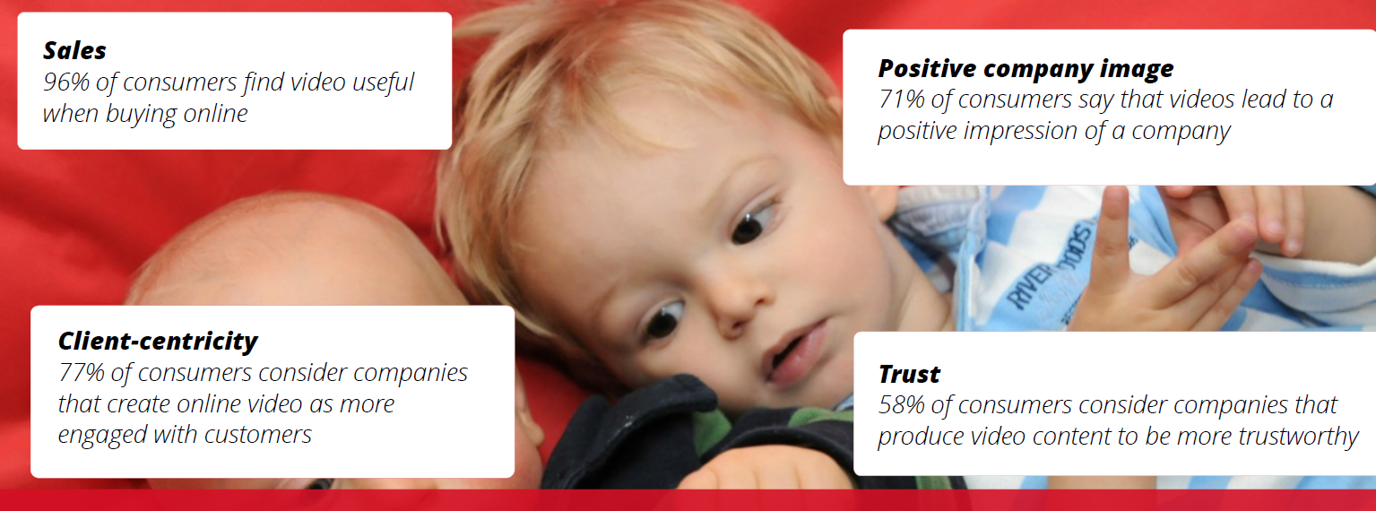
Visual interaction increases engagement and trust
Reference: Google data December 2014
SCE1541 Date of preparation May 2015

Slide 5
The smoking cessation environment has transformed in the last few years
The Situation
19% decline in people making quit attempts through stop smoking services vs 2013¹
Smoking cessation prescription market has shrunk by 25% in the last year²
We must convince smokers who want to quit that they are 4 times more likely to succeed with the help of a healthcare professional
References
HSCIC Stop Smoking Service data August 2014
IMS data 2013 vs 2014
SCE1541 Date of preparation May 2015

Slide 6
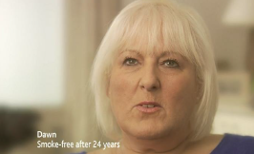
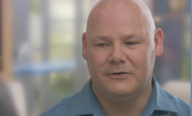
THE EXPERIMENT
Smokers are online – 50% target audience use YouTube once a week
Action:
deliver current unbranded TV ads through targeted paid media on YouTube
TrueView ads to targeted consumers in front of searched videos.
There is an option for the viewer to skip the ad after 5 seconds, Pfizer only pays for views longer than 30 seconds
TrueView, in-search, in-display: from 1st January – 22nd March
In 10 weeks:
First 5 seconds seen 8.2m times
Ads viewed 914k times by 637k people
Reference: Google data December 2014
SCE1541 Date of preparation May 2015

Slide 7
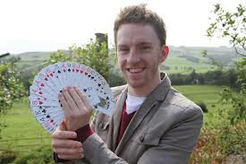
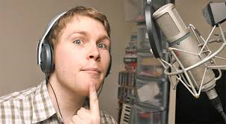
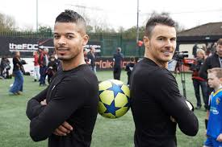
DEVELOPING THE EXPERIMENT TO CROWDSOURCE
Target reach:
7m impressions, 1m unique viewers, 39k go to HCP
5 Talented YouTube Celebrities have made a video each to deliver the message that “you are 4 times more likely to quit smoking with the help of a healthcare professional” in their own unique style
Campaign ran from 23rd March to 29th May to raise money for QUIT and Roy Castle Lung Cancer Foundation
Charitable donations:
10p when TrueView ad watched 25% or more
1p for every like
1p for every click through to www.quitwithhelp.co.uk
SCE1541 Date of preparation May 2015
Notes:
Verbalise they have 3 million channel subscribers between them

Slide 8
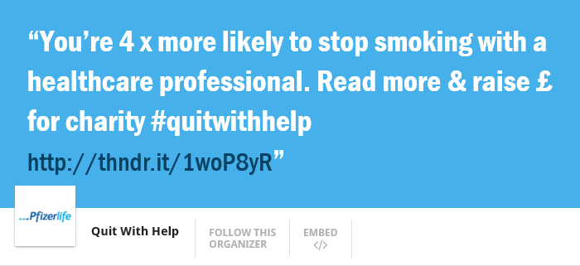
A Novel Approach to Promoting the campaign BEFORE it launches
A Thunderclap on 23rd March to launch the campaign
Borrowing social media profiles of supporters at the specified time and date
Rallying support through social media BEFORE the campaign to shout out a smoking cessation and campaign awareness message, timed to hit the launch of the YouTube campaign
SCE1541
Date of preparation
May 2015

Slide 9
THE VIDEOS
Steven Bridges #quitwithhelp
F2Freestylers #quitwithhelp
www.youtube.com/pfizeruk
SCE1541 Date of preparation May 2015

Slide 10
After week 7 ALL of the targets for views, reach and charitable donations were met
Results
Thunderclap launched project on 23rd March 2015 with a social reach of 52k
6 videos live on Pfizer UK YouTube channel – 5 have paid media behind them
Results for weeks 1-6:
7.9m impressions of first 5 seconds
1.7m views from 1.4m unique viewers (680k views organic)
14k clicks through to Quit with Help website - bounce rate 92%
Charitable donation cap was £20k
This was reached after week 2 of the campaign
SCE1541 Date of preparation May 2015

Slide 11
What have we learnt?
Telling a story is different on YouTube/video.
You need to get your message across in the first 5 seconds to perform well and create engaging “hero” content that will appeal to the audience so they keep watching
A positive, upbeat, supportive and consistent message is received VERY well by consumers when it comes to smoking cessation
Engage the smoking cessation community early on
TrueView learns!
SCE1541 Date of preparation May 2015

Slide 12
THANK YOU FOR LISTENING
ANY QUESTIONS?
SCE1541 Date of preparation May 2015

